Slide 1
U.S. Data Center Infrastructure: A Comprehensive Design Document for Technical Training
This design document outlines an instructional approach for developing a self-paced technical course on U.S. data center operations and infrastructure. The course targets corporate trainers and instructional designers who are creating learning experiences for diverse adult learners in IT operations and data center management. The document incorporates two distinct instructional strategies—scenario-based learning and gamified challenges—to enhance knowledge retention and practical application. Through careful attention to accessibility standards, inclusive design principles, and learner engagement techniques, this framework ensures all participants can successfully navigate the complexities of modern data center environments.

Slide 2



Understanding Data Center Fundamentals
What Is a Data Center?
Processing Power
A data center is a specialized facility that serves as the backbone of modern technological infrastructure. These facilities are designed to store, process, and manage digital data that supports a wide range of online services and applications—from banking systems and cloud computing platforms to hardware management software and enterprise applications.
Data centers bring computing equipment and data together in centralized, secure locations. They require significant power resources, robust cooling systems to prevent equipment overheating, and extensive network connectivity to handle vast amounts of data traffic. Due to their critical role in supporting digital services, data centers implement enhanced security measures including surveillance cameras and biometric screening systems.
High-performance servers handle computational workloads
Data Storage
Storage systems house digital information securely
Network Infrastructure
Hardware enables data transmission and connectivity

Slide 3




The Four Primary Data Center Types
The U.S. market encompasses a diverse mix of data center types, each serving distinct operational purposes and business models. Understanding these categories is essential for professionals working in IT infrastructure and operations management.
Hyperscale Data Centers
Colocation Data Centers
Operated by technology giants such as Amazon Web Services (AWS), Google, and Microsoft to support massive, scalable cloud computing and artificial intelligence workloads. These facilities are often vast, centralized campuses designed for maximum efficiency and scalability.
Facilities where multiple businesses rent space, power, and cooling infrastructure for their own equipment. Major providers like Equinix and Digital Realty manage the physical infrastructure while clients maintain operational control of their hardware.
Enterprise Data Centers
Edge Data Centers
Privately owned and operated by a single organization for its exclusive IT needs. These facilities can be located on-premises at corporate headquarters or maintained at off-site locations for business continuity purposes.
Smaller, decentralized facilities positioned closer to end users to minimize latency and improve response times. These centers support applications like 5G networks and Internet of Things (IoT) devices that require faster, real-time data processing.

Slide 4
Market Overview and Growth Projections
The U.S. data center market represents a multi-billion-dollar industry valued at over $100 billion, with projections indicating strong continued growth. This expansion is driven primarily by increasing demand from cloud computing services and artificial intelligence applications, which require substantial processing power and storage capacity.
$100B+
25%
3
Current Market Value
Projected Growth Rate
Major Deployment Models
Total valuation of the U.S. data center industry
Expected annual market expansion through 2028
On-premises, colocation, and cloud-based solutions
The market is increasingly characterized by hybrid approaches, where companies utilize a combination of their own infrastructure and cloud-based data center resources. This trend reflects the growing need for flexibility, scalability, and cost optimization in IT operations. Significant investments from industry leaders like Equinix and Digital Realty continue to shape the competitive landscape.

Slide 5
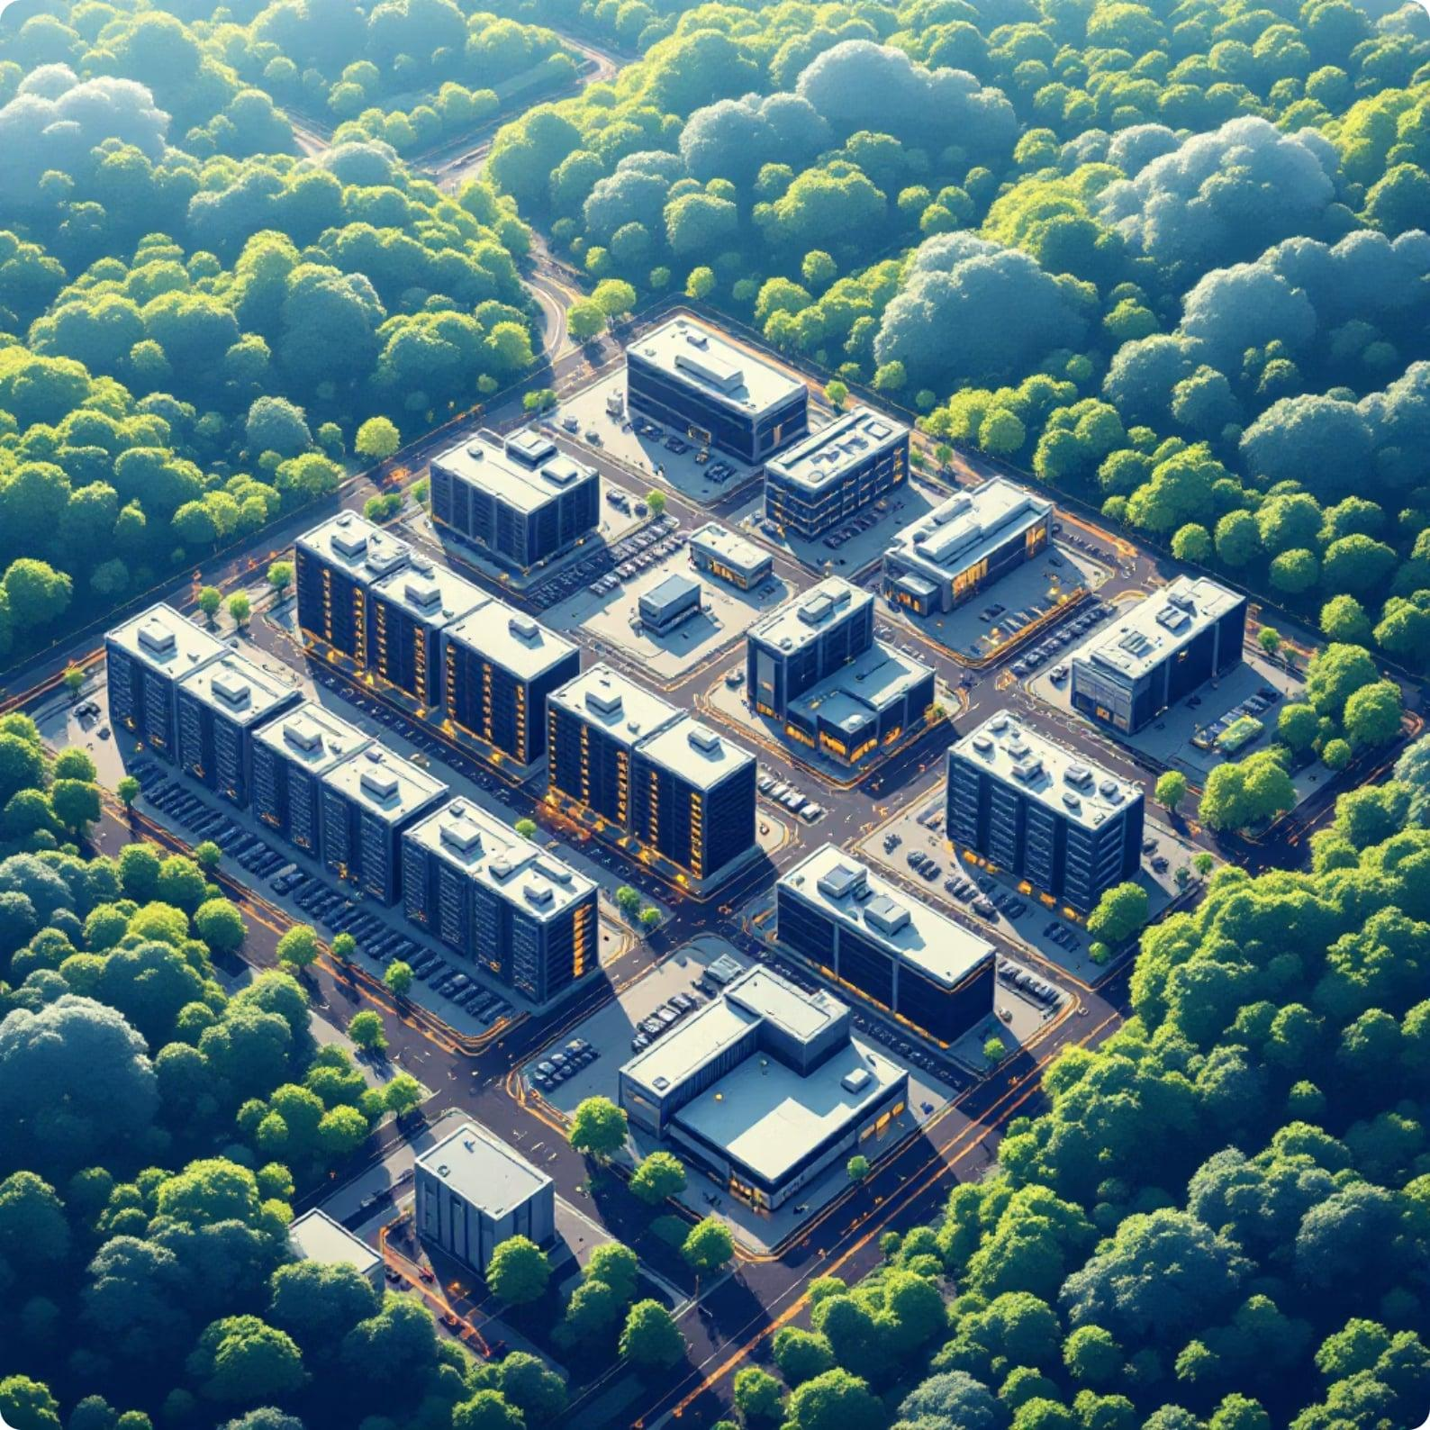




Major U.S. Data Center Geographic Hubs
Strategic Location Factors
Data center location selection depends on several critical infrastructure factors including access to extensive fiber-optic networks, proximity to major population centers, availability of reliable power supplies, and favorable regulatory environments.
Northern Virginia (Ashburn)
Northern California (Silicon Valley)
New Jersey and Illinois Regions
These markets host major data center operations driven by high demand from financial services, healthcare, and enterprise sectors. Strong infrastructure and connectivity to metropolitan areas make these regions strategically valuable.
One of the largest data center markets globally, featuring extensive fiber networks and proximity to major East Coast population centers. The region's nickname "Data Center Alley" reflects its dominant position in the industry.
A hub for technological innovation with high concentrations of data centers supporting the region's technology companies, startups, and research institutions. The area benefits from proximity to major cloud service providers and tech enterprises.

Slide 6
Critical Infrastructure and Operational Requirements
Data centers demand sophisticated infrastructure systems to ensure continuous, reliable operations. Understanding these requirements is fundamental for professionals managing or designing data center facilities.
01
02
Power Supply and Distribution
Cooling and Climate Control
Robust cooling systems prevent equipment overheating and maintain optimal operating temperatures. Modern facilities employ advanced cooling technologies including hot-aisle/cold-aisle configurations, liquid cooling, and free-air cooling where climate permits.
Data centers require significant electrical power to operate servers, storage systems, and networking equipment. Redundant power systems, including backup generators and uninterruptible power supplies (UPS), ensure continuity during outages.
03
04
Network Connectivity
Physical Security Measures
Extensive network infrastructure enables data transmission and connectivity to handle vast amounts of information. Multiple fiber-optic connections and redundant network paths ensure reliability and performance.
Enhanced security protocols protect critical infrastructure from unauthorized access. Facilities implement surveillance cameras, biometric screening, mantrap entries, and 24/7 security personnel monitoring.

Slide 7
Industry Challenges and Emerging Concerns
Power Supply Constraints
Navigating Complex Market Dynamics
Growing demand outpaces available electrical capacity
The U.S. data center industry faces several interconnected challenges that impact development and operations. A lack of sufficient power supply represents a growing constraint in established markets, as expanding facilities require electrical capacity that often exceeds local utility availability. This challenge is compounded by limited land availability in prime locations, driving up real estate costs and forcing developers to explore secondary markets.
Environmental sustainability has emerged as a critical concern, with stakeholders increasingly focused on developing energy-efficient solutions, renewable energy integration, and carbon footprint reduction. Simultaneously, heightened cybersecurity threats require constant vigilance and investment in protecting facilities and the vast quantities of sensitive data they house. Organizations must balance these competing demands while maintaining operational excellence and cost effectiveness.
Land Availability
Limited space in established markets drives costs
Sustainability Pressure
Environmental impact and energy efficiency concerns
Cybersecurity Threats
Protecting vast data quantities from evolving attacks

Slide 8




Instructional Strategy 1: Scenario-Based Learning
Immersive Problem-Solving Through Real-World Contexts
Scenario-based learning places learners in realistic, job-relevant situations that require them to apply technical knowledge and make critical decisions. This instructional strategy enhances transfer of learning by contextualizing abstract concepts within authentic workplace challenges.
Scenario Presentation
Analysis and Decision Making
Feedback and Reflection
Learners receive a detailed case describing a data center operational challenge, such as responding to a power failure or capacity planning for growth.
Participants analyze the situation, consider multiple variables, and select appropriate responses from branching options that reflect real-world complexity.
The system provides immediate, specific feedback explaining the consequences of decisions and guiding learners toward optimal solutions and best practices.
Accessibility Consideration: Scenarios include text descriptions, optional audio narration with transcripts, and keyboard-navigable decision trees to accommodate diverse learning needs and assistive technology users.

Slide 9




Instructional Strategy 2: Gamified Challenge System
Gamification incorporates game design elements into learning experiences to increase motivation, engagement, and knowledge retention. This strategy leverages achievement systems, progress tracking, and competitive elements to sustain learner interest throughout self-paced modules.
Implementation Framework
Learners progress through a series of increasingly complex challenges that test their understanding of data center concepts. Each module presents missions such as "Optimize a colocation facility's cooling efficiency" or "Design a security protocol for a hyperscale center."
The system awards points, badges, and certifications for completing challenges, mastering concepts, and demonstrating advanced competencies. Leaderboards (optional, privacy-respecting) provide social motivation, while personal progress dashboards help learners track their journey and identify knowledge gaps.
There was an error generating this image
75%
60%
50%
Engagement Increase
Retention Improvement
Completion Rate Gain
Studies show gamification can boost learner engagement significantly
Game elements improve information retention compared to traditional methods
Gamified courses demonstrate higher completion rates

Slide 10


Ensuring Accessibility, Inclusivity, and Learner Engagement
Effective self-paced technical training must accommodate diverse learner needs, abilities, and preferences. This design document incorporates universal design for learning (UDL) principles and Web Content Accessibility Guidelines (WCAG) 2.1 Level AA standards to create an inclusive learning environment.
Multiple Means of Representation
Interactive Elements and Navigation
Content is delivered through text, diagrams, video demonstrations with captions, and audio descriptions. Learners can adjust text size, contrast ratios, and access content in formats that match their preferences and needs.
All interactive components are keyboard-accessible and compatible with screen readers. Clear navigation structures, progress indicators, and skip-navigation options allow learners to move efficiently through content. Interactive simulations include alternative text-based completion paths.
Flexible Pacing and Assessment
Inclusive Language and Examples
Learners control their pace without time pressure, with the ability to save progress and return at convenient intervals. Multiple assessment formats—including scenario responses, knowledge checks, and practical simulations—accommodate different demonstration preferences.
Course content employs clear, jargon-free language with definitions for technical terms. Examples and scenarios feature diverse professionals in various roles, avoiding stereotypes and representing the broad spectrum of individuals working in data center operations.
By integrating scenario-based learning, gamified challenges, and comprehensive accessibility features, this instructional design creates an engaging, effective learning experience that prepares diverse adult learners for success in data center and IT operations roles.

